Slide 1




SWP391 Final Presentations
INTERIOR CONSTRUCTION QUOTATION SYSTEM
FPT UNIVERSITY
Supervisor:
Nguyễn Thị Cẩm Hương
Team 7:
1.Nguyễn Trần Tấn Phát SE173198
2.Phạm Hoàng Khiêm SE170605
3.Đỗ Hồng Quân SE160325
4.Lê Phạm Khang SE161421

Slide 2
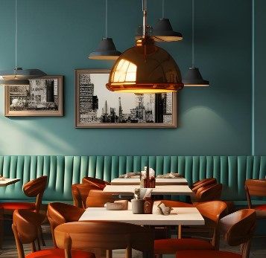


Table of Content
1.Project introduction
2.System Architectural Overview
3.Actor & Features
4.Demonstration
5. Outcome
6. Q & A

Slide 3




1.Project introduction
-Technology:
Swagger
ASP.NET Core
Reactjs
SQl Sever

Slide 4
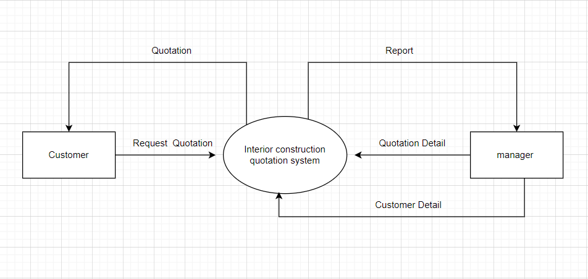
Context Diagram

Slide 5
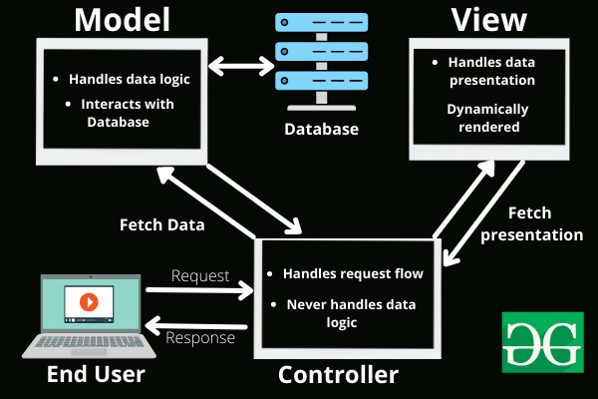
2.System Architectural Overview

Slide 6



3.Actor & Features
Staff
Admin
Customer
Search
View Post
Requests quotation
View quotation
Feedback
Quotation management
+Create quotation
+Send quotation
+Confirm quotation
Account Management
+ Add new account
+ Remove account
+ Update account

Slide 7



4.Demonstration
Role : Customer
Opend web
View products
Request quotation

Slide 8


Role : Staff
Opend web
Check dashboard
Send quotation

Slide 9


Role : Admin
Opend web
management records
management account

Slide 10
5. Outcome
Lessons
Learned
Application Achievement
Projects Deliverable
Limitation

Slide 11
Lessons Learned
Teamwork
Project management
Time management
software development management lifecycle

Slide 12
Application Achievement
Provides a quote support platform
Customer features: request quotation,Search,View Post, Feedback
Staff features: Quotation management
Admin features: Account Management
Projects Deliverable
Source code: GitHub
Documents

Slide 13

Limitation:
Project Complexity Omission
Limited Scope
Multi-language support not yet

Slide 14
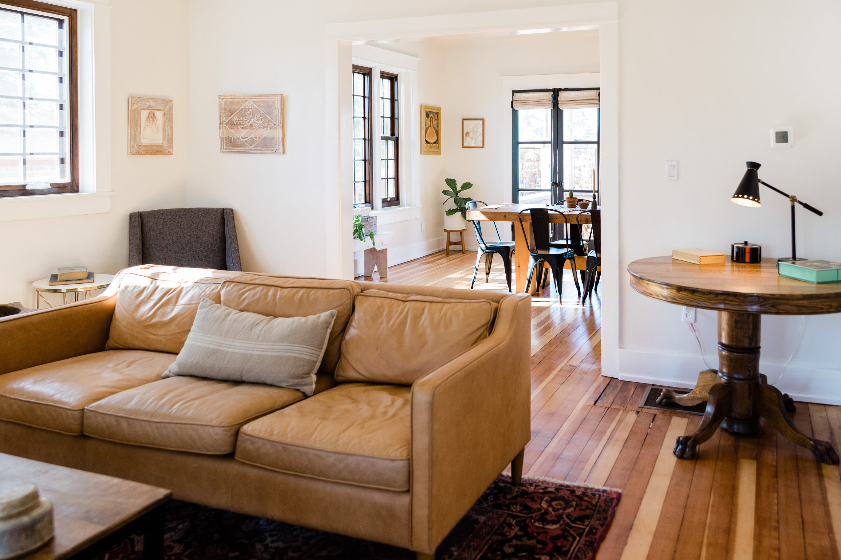
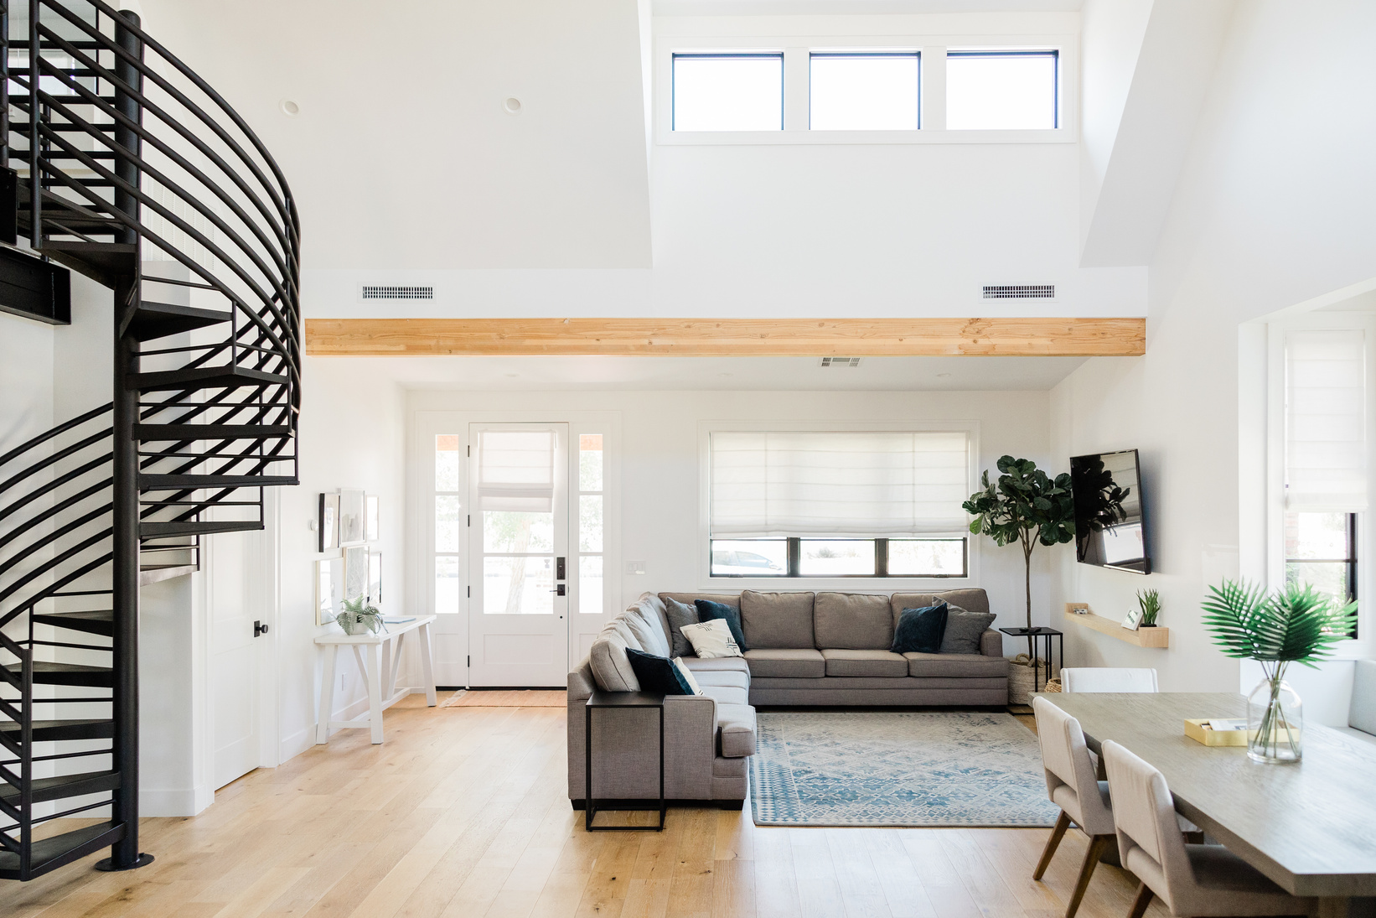
Thanks you for your listening
Q&A

